Slide 1
A Study on Summer Olympic Medal Tallies
Exploring the relation between race/ethnicity and chances of winning a medal

Slide 2
Core Idea
This is a study to answer the following questions
Does it make any difference if you are from one geopolitical region or the other on your chances to win a medal in the Summer Olympics
If so, which regions do better than the others and by how much?
What other parameters could affect your chances, does gender play a role?
A prediction based on the analysis for the 2020 Summer Olympics medal count

Slide 3
Dataset
The dataset to be used is from an open source repository
The data was compiled by the IOC Research and Reference Service
It has the following information
A list of all the medal winners in the Summer Olympics from 1896 to 2008, with information about Year, Event Category, Sport Name, Event Name, Gender, Country Code, Medal

Slide 4
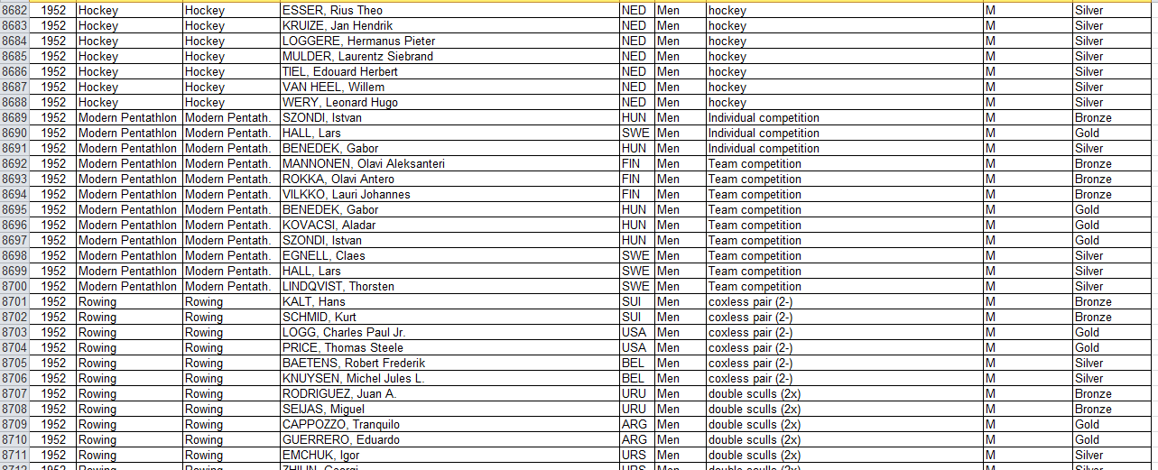
A Sample from the Dataset

Slide 5
Limitations of the Dataset
Due to changing global politics and logistic reasons, country codes, as maintained by the IOC, have changed for some countries over the years
This means the same countries can have different codes in different editions of the Summer Olympics

Slide 6
Limitations of the Dataset (contd.)
Another shortcoming is that it is not arranged in the format we require it to be in – grouped by geopolitical region
Thus we had to find a way to group the countries by region and also take care of the obsolete country codes

Slide 7
Proposed Solution/Preprocessing
Based on fact sheets, linguistics, economic conditions and historical ties (USSR, etc.), we have arranged the countries in the following categories
Northern America
Central America
Southern America
Western Europe
Eastern Europe
Central Europe
Northern Europe
Africa
Australia
Middle East
Indian Subcontinent
East Asia
South East Asia
Minorities and Others

Slide 8
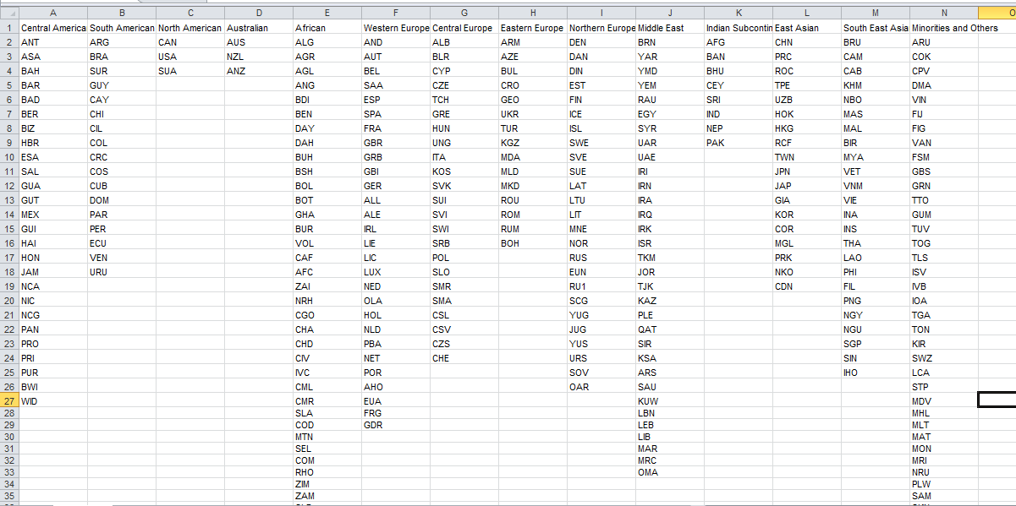

Slide 9
Further Processing
We plan to use R (via RStudio) to apply transformations and group the data to suit our purposes
With the help of R, we can arrive at medal count per region, split by medal type and gender
Other ways to group the data can also be considered, to explore different aspects of the problem

Slide 10
Plan for the Final Product
The various libraries available for R can then be used to plot the data such that it is easily readable and the message behind this study (mainly the answers to the questions presented earlier) are expressed without ambiguity

Slide 11
Group Members
Done By
MUDIT BHARTIA (16BCE1100)
KAUSHIK CHATTERJEE (16BCE1067)
HARSHIT MAHESHWARI (16BCE1046)

